Slide 1
Data Exploration
Data exploration can be broadly classified into two types—descriptive statistics and data visualization.
Descriptive statistics is the process of condensing key characteristics of the dataset into simple numeric metrics. Some of the common quantitative metrics used are mean, standard deviation, and correlation.
Visualization is the process of projecting the data, or parts of it, into multi-dimensional space or abstract images. All the useful (and adorable) charts fall under this category.
Data exploration in the context of data science uses both descriptive statistics and visualization techniques.

Slide 2
OBJECTIVES OF DATA EXPLORATION
1. Data understanding: Data exploration provides a high-level overview of each attribute (also called variable) in the dataset and the interaction between the attributes. Data exploration helps answers the questions like what is the typical value of an attribute or how much do the data points differ from the typical value, or presence of extreme values.
2. Data preparation: Before applying the data science algorithm, the dataset has to be prepared for handling any of the anomalies that may be present in the data. These anomalies include outliers, missing values, or highly correlated attributes. Some data science algorithms do not work well when input attributes are correlated with each other. Thus, correlated attributes need to be identified and removed.
3. Data science tasks: Basic data exploration can sometimes substitute the entire data science process. For example, scatterplots can identify clusters in low-dimensional data or can help develop regression or
classification models with simple visual rules.
4. Interpreting the results: Finally, data exploration is used in understanding the prediction, classification, and clustering of the results of the data science process. Histograms help to comprehend the distribution of the attribute and can also be useful for visualizing numeric prediction, error rate estimation, etc.

Slide 3
DESCRIPTIVE STATISTICS
Descriptive statistics refers to the study of the aggregate quantities of a dataset. Descriptive statistics can be broadly classified into
Univariate Exploration
Multivariate Exploration

Slide 4
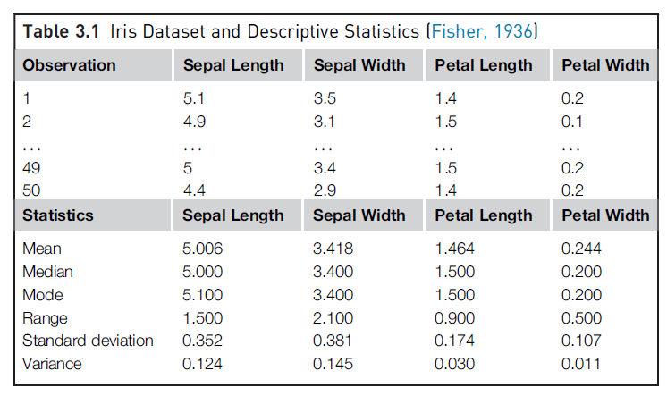
DESCRIPTIVE STATISTICS: Univariate Exploration
Univariate data exploration denotes analysis of one attribute at a time. The example Iris dataset for one species, setosa, has 50 observations and 4 attributes. Here some of the descriptive statistics are explored.
Measure of Central Tendency: The objective of finding the central location of an attribute is to quantify the dataset with one central or most common number.
Mean:
The mean is the arithmetic average of all observations in the dataset. It is calculated by summing all the data points and dividing by the number of data points

Slide 5
DESCRIPTIVE STATISTICS: Univariate Exploration
Median: The median is the value of the central point in the distribution. The median is calculated by sorting all the observations from small to large and selecting the mid-point observation in the sorted list. If the number of data points is even, then the average of the middle two data points is used as the median. The median for sepal length is in centimeters is 5.0000.
Mode: The mode is the most frequently occurring observation. In the dataset, data points may be repetitive, and the most repetitive data point is the mode of the dataset. In this example, the mode in
centimeters is 5.1000.

Slide 6
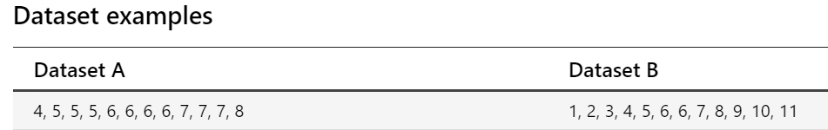
DESCRIPTIVE STATISTICS: Univariate Exploration
Measure of Spread: Summarizing the dataset can help us understand the data, especially when the dataset is large. The mode, median, and mean summarize the data into a single value that is typical or representative of all the values in the dataset, but this is only part of the 'picture' that summarizes a dataset.
Measures of spread describe how similar or varied the set of observed values are for a particular variable (data item). Measures of spread summarize the data in a way that shows how scattered the values are and how much they differ from the mean value.
:

Slide 7
DESCRIPTIVE STATISTICS: Univariate Exploration
The mode (most frequent value), median (middle value*) and mean (arithmetic average) of both datasets is 6. If we just looked at the measures of central tendency, we may assume that the datasets are the same.
However, if we look at the spread of the values in the following graph, we can see that Dataset B is more dispersed than Dataset A. Used together, the measures of central tendency and measures of spread help us to better understand the data.

Slide 8
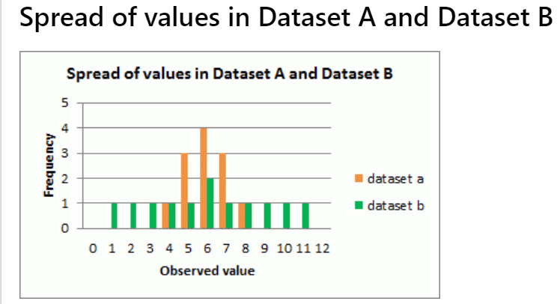
DESCRIPTIVE STATISTICS: Univariate Exploration

Slide 9
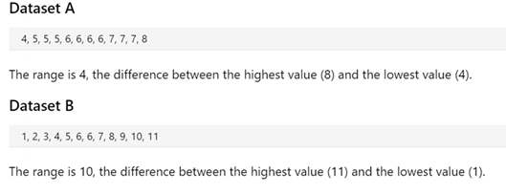
DESCRIPTIVE STATISTICS: Univariate Exploration
Measure of spread, sometimes also called a measure of dispersion, is used to describe the variability in a sample or population .There are two common metrics to quantify spread: Range and Deviation.
Range: The range is the difference between the maximum value and the minimum value of the attribute.
:

Slide 10
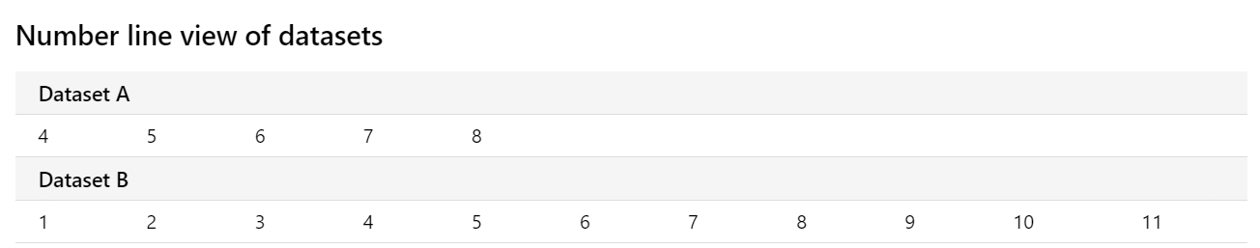
DESCRIPTIVE STATISTICS: Univariate Exploration
On a number line, we can see that the range of values for Dataset B is larger than Dataset A.

Slide 11

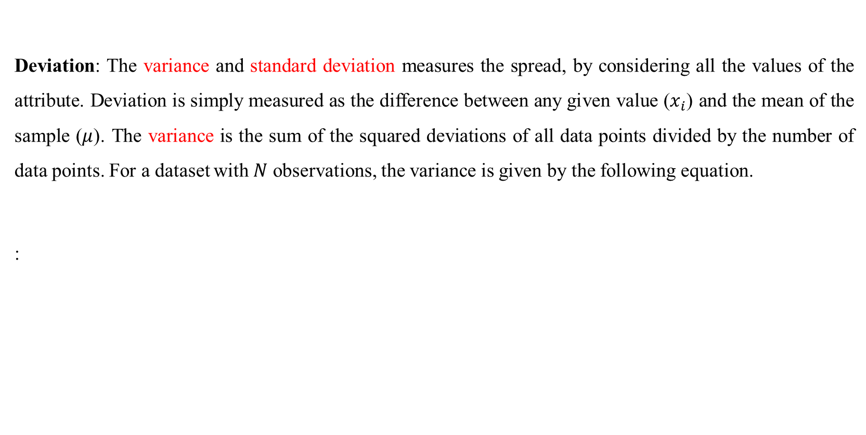
DESCRIPTIVE STATISTICS: Univariate Exploration
Deviation: The variance and standard deviation measures the spread, by considering all the values of the attribute. Deviation is simply measured as the difference between any given value ($x_{i}$) and the mean of the sample ($μ$). The variance is the sum of the squared deviations of all data points divided by the number of data points. For a dataset with $N$ observations, the variance is given by the following equation.
:

Slide 12
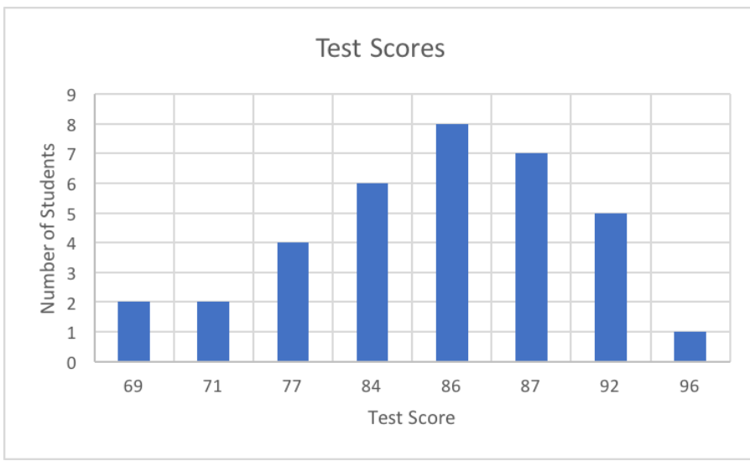
DESCRIPTIVE STATISTICS: Univariate Exploration
Standard deviation is the square root of the variance. Standard deviation measures how much your entire data set differs from the mean.
High standard deviation means the data points are spread widely around the central point. Low standard deviation means data points are closer to the central point.
In the following graph, the mean is 84.47, the standard deviation is 6.92 and the distribution looks like this:

Slide 13
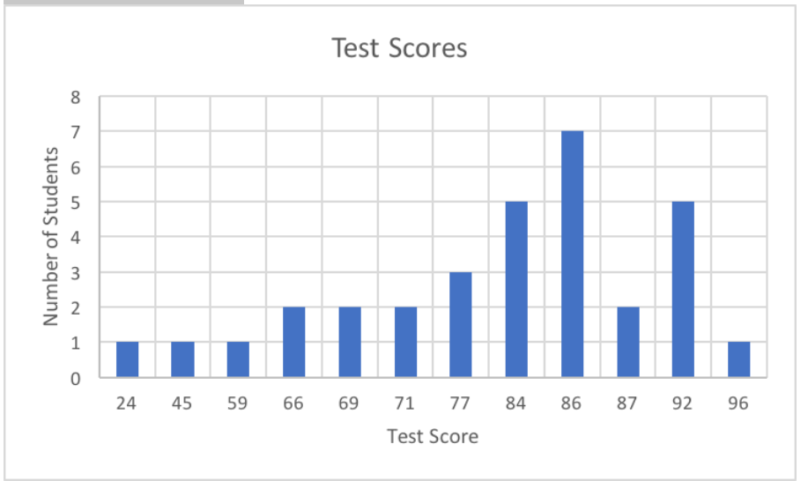
DESCRIPTIVE STATISTICS: Univariate Exploration
In this second graph, the mean is 80, the standard deviation is 14.57 , and the distribution looks like this

Slide 14
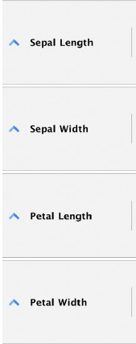
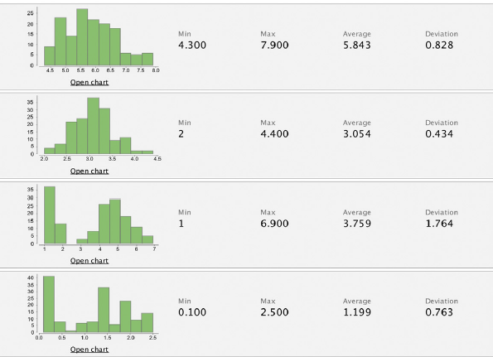
DESCRIPTIVE STATISTICS: Univariate Exploration
The following figure provides the univariate summary of the Iris dataset with all 150 observations, for each of the four numeric attributes.

Slide 15
An example with details
Imagine we have a dataset of exam scores of 10 students:
Descriptive Statistics
Mean (Average):
(85+78+92+67+88+75+90+82+79+95)/10
=831/10=83.1
Median:
Ordered scores: 67, 75, 78, 79, 82, 85, 88, 90, 92, 95
Median = Average of 5th and 6th values = (82 + 85) / 2 = 83.5
Minimum Score: 67, Maximum Score: 95
Range:95 − 67 = 28
Student | Score
A | 85
B | 78
C | 92
D | 67
E | 88
F | 75
G | 90
H | 82
I | 79
J | 95

Slide 16
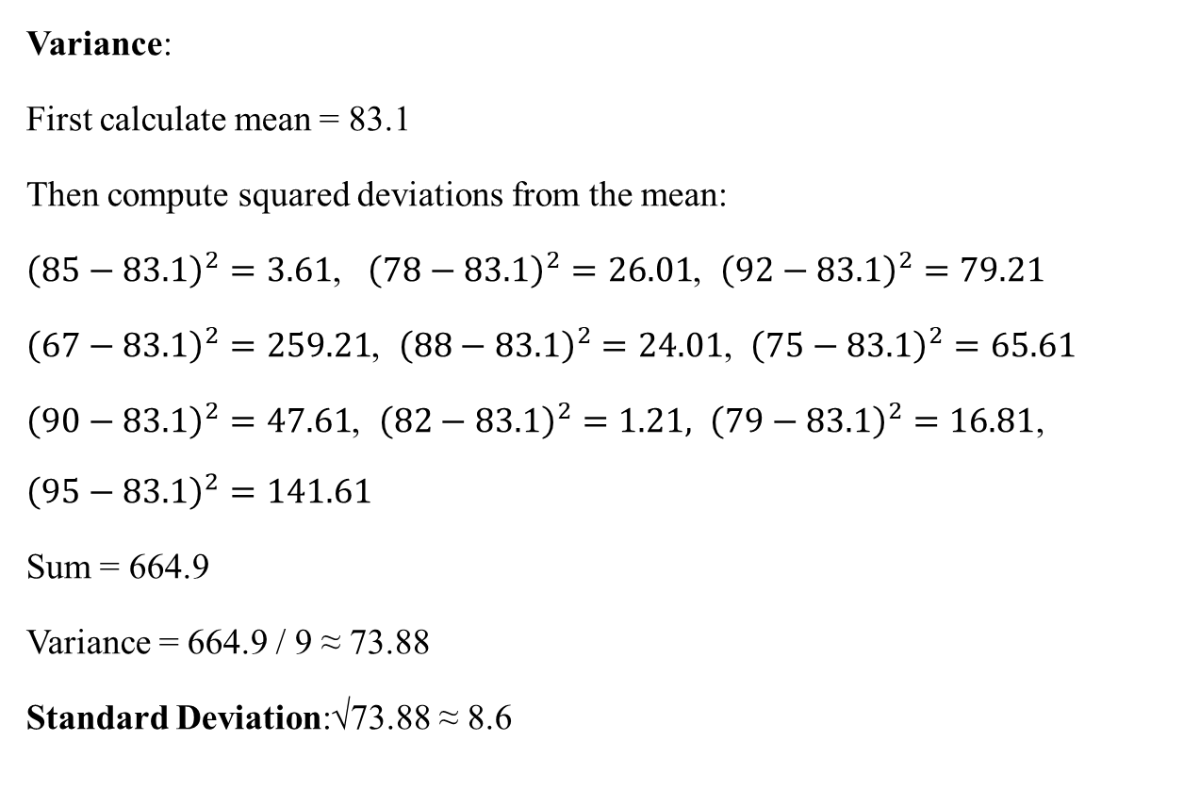
An example with details
Variance:
First calculate mean = 83.1
Then compute squared deviations from the mean:
${\left(85−83.1\right)}^{2}=3.61$, ${\left(78−83.1\right)}^{2}=26.01$, ${\left(92−83.1\right)}^{2}=79.21$
${\left(67−83.1\right)}^{2}=259.21$, ${\left(88−83.1\right)}^{2}=24.01$, ${\left(75−83.1\right)}^{2}=65.61$
${\left(90−83.1\right)}^{2}=47.61$, ${\left(82−83.1\right)}^{2}=1.21, {\left(79−83.1\right)}^{2}=16.81$,
$${\left(95−83.1\right)}^{2}=141.61$$
​Sum = 664.9
Variance = 664.9 / 9 ≈ 73.88
Standard Deviation:√73.88 ≈ 8.6
Student | Score
A | 85
B | 78
C | 92
D | 67
E | 88
F | 75
G | 90
H | 82
I | 79
J | 95

Slide 17
Exercise 1
You have two datasets representing the monthly test scores (out of 100) for students in two different classes:
Class X: 75, 78, 80, 82, 85, 87
Class Y: 60, 65, 75, 80, 90, 95
Tasks:
1. Calculate the range, variance, and standard deviation for each class.
2. Which class shows more variability in test scores?
3. What might this indicate about the performance consistency among students in each class?

Slide 18
Exercise 2
You are given the following dataset representing the number of hours 10 employees worked
last week:
40, 42, 38, 41, 44, 39, 40, 37, 60, 38
Tasks
1. Calculate the mean and median of the dataset.
2. Which measure (mean or median) better represents the central tendency of the data?
3. Justify your answer considering the effect of any outlier(s).

Slide 19
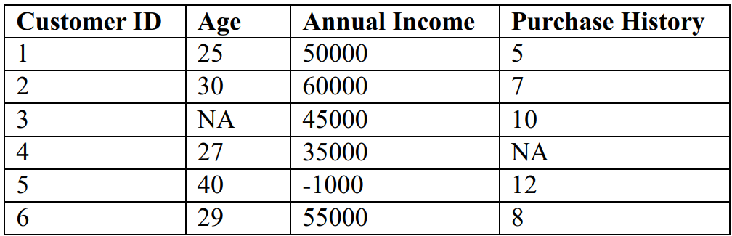
Exercise 3
You are working with a dataset containing customer information for an online retail store.
The columns in the dataset include:
• Customer ID: Unique identifier for each customer
• Age: Age of the customer
• Annual Income: The annual income of the customer (in USD)
• Purchase History: Number of purchases made by the customer

Slide 20
Exercise 3
Tasks:
1. Identify any missing values in the dataset and describe how you would handle them.
2. Identify any incorrect values in the dataset (e.g., negative income) and explain how
you would correct or handle them.
3. Discuss the potential impact of missing or incorrect data on any analysis or modeling
you might perform with this dataset.

Slide 21
Data Exploration
Data exploration can be broadly classified into two types—descriptive statistics and data visualization.
Descriptive statistics is the process of condensing key characteristics of the dataset into simple numeric metrics. Some of the common quantitative metrics used are mean, standard deviation, and correlation.
Visualization is the process of projecting the data, or parts of it, into multi-dimensional space or abstract images. All the useful (and adorable) charts fall under this category.
Data exploration in the context of data science uses both descriptive statistics and visualization techniques.
Univariate Exploration (in the previous slide)
Multivariate Exploration

Slide 22
DESCRIPTIVE STATISTICS: Multivariate Exploration
Multivariate Data Exploration refers to the process of analyzing more than two variables simultaneously to understand relationships, patterns, or structures in a dataset.
It's an important step in exploratory data analysis (EDA), especially when working with real-world datasets where multiple features interact.
Why Multivariate Analysis?
To discover interdependencies between variables.
To identify patterns or trends that are not obvious from univariate or bivariate analysis.
To reduce dimensionality or detect redundant or highly correlated features.
To prepare the dataset for predictive modeling.

Slide 23
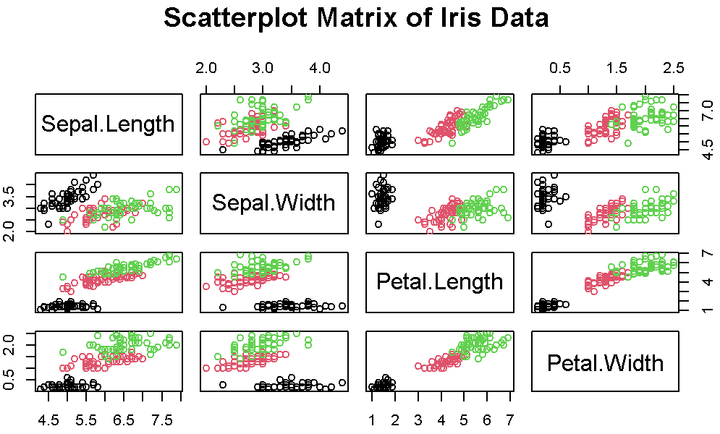
DESCRIPTIVE STATISTICS: Multivariate Exploration
Common Techniques with Examples
1. Pair Plot (Scatterplot Matrix)
Shows relationships between all pairs of numeric variables in a dataset.
pairs(iris[, 1:4], main = "Scatterplot Matrix of Iris Data", col = iris$Species)
Use: Helps detect correlations and clustering between variables like Sepal Length, Petal Width, etc., grouped by Species.

Slide 24
DESCRIPTIVE STATISTICS: Multivariate Exploration
2. Correlation
Correlation measures the statistical relationship between two attributes, particularly dependence of one attribute on another attribute.
For example, consider average temperature of the day and ice cream sales. Statistically, the two attributes that are correlated are dependent on each other and one may be used to predict the other.
If there are sufficient data, future sales of ice cream can be predicted if the temperature forecast is known.

Slide 25
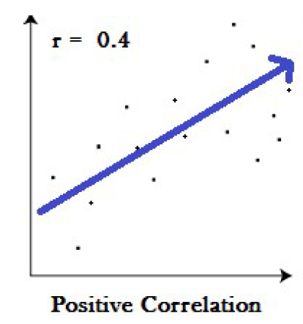
DESCRIPTIVE STATISTICS: Multivariate Exploration
Correlation: Positive correlation:
A positive correlation is a relationship between two variables in which both variables move in the same direction.
Therefore, when one variable increases as the other variable increases, or one variable decreases while the other decreases.

Slide 26
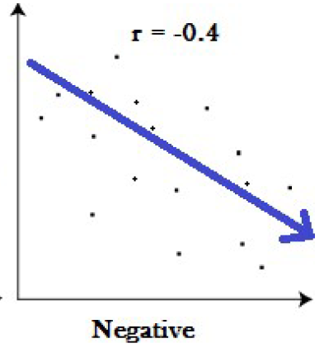
DESCRIPTIVE STATISTICS: Multivariate Exploration
Correlation: Negative correlation:
A negative correlation is a relationship between two variables in which an increase in one variable is associated with a decrease in the other.
Example: Price and demand of a commodity.

Slide 27
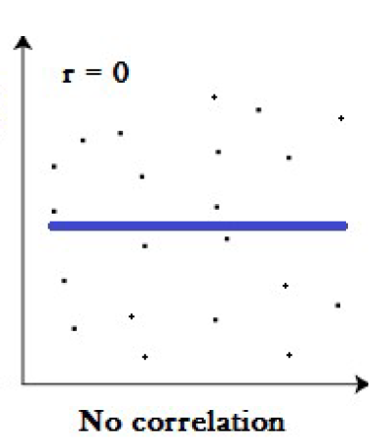
DESCRIPTIVE STATISTICS: Multivariate Exploration
Correlation: Zero correlation:
A zero correlation exists when there is no relationship between two variables. For example there is no relationship between the amount of tea drunk and level of intelligence.

Slide 28
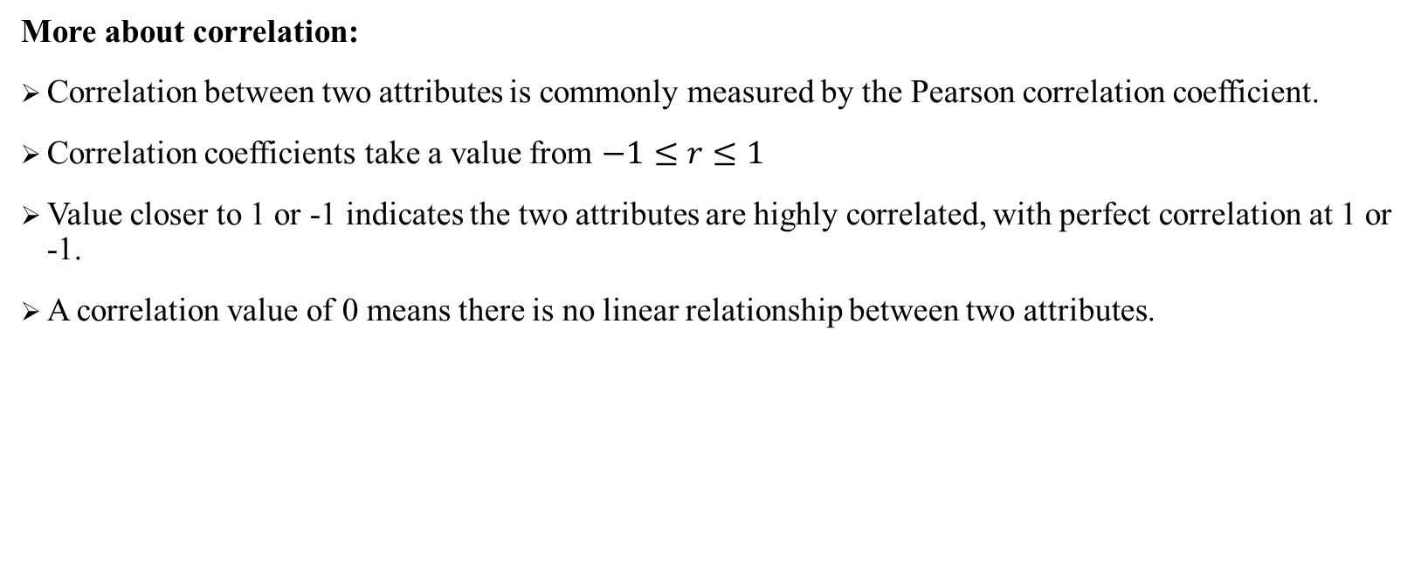
DESCRIPTIVE STATISTICS: Multivariate Exploration
More about correlation:
Correlation between two attributes is commonly measured by the Pearson correlation coefficient.
Correlation coefficients take a value from $−1≤r≤1$
Value closer to 1 or -1 indicates the two attributes are highly correlated, with perfect correlation at 1 or -1.
A correlation value of 0 means there is no linear relationship between two attributes.

Slide 29
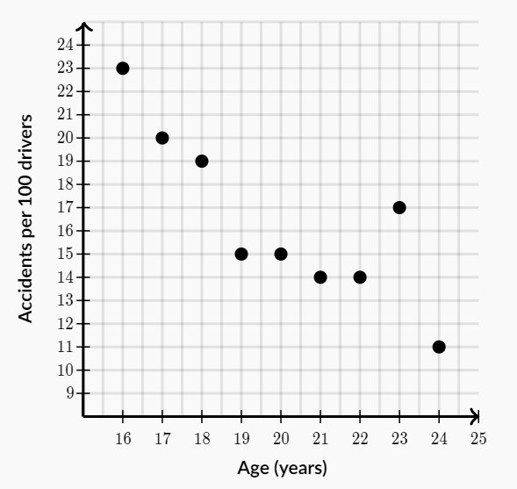
DESCRIPTIVE STATISTICS: Multivariate Exploration
Correlation Example:
The graph shown below shows the relationship between the age of drivers and the number of car accidents per 100 drivers in the year 2009.
What is the best description of this relationship?

Slide 30
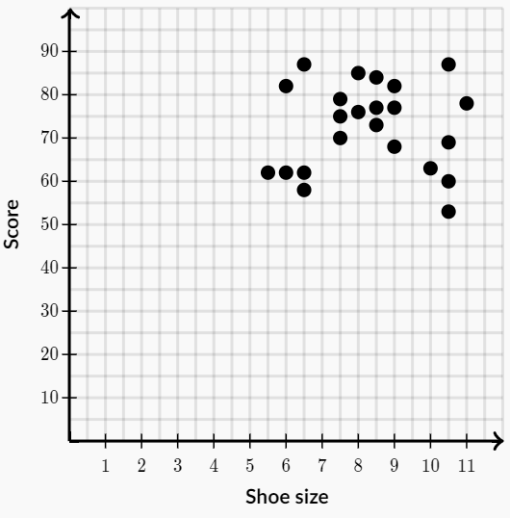
DESCRIPTIVE STATISTICS: Multivariate Exploration
Correlation Example:
The graph below shows the relationship between test grades and shoe sizes of the students in University class.
What is the best description of this relationship?

Slide 31
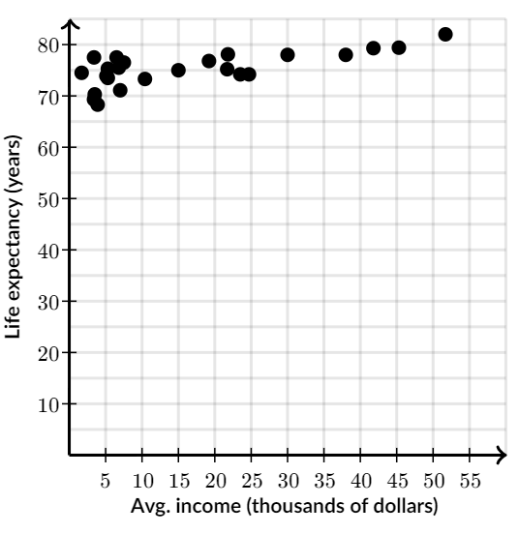
DESCRIPTIVE STATISTICS: Multivariate Exploration
Correlation Example:
The graph below shows the relationship between life expectancy and income in a random sample of countries.
What is the best description of this relationship?

Slide 32
Multivariate Exploration
Remember: Correlation does not mean causation. The phrase “correlation does not imply causation” is often used in statistics to point out that correlation between two variables does not necessarily mean that one variable causes the other to occur.
Example 1: Ice Cream Sales & Shark Attacks ?.
Example 2: High School Graduates vs. Pizza Consumption ?
Example 3: Master’s Degrees vs. Box Office Revenue ?

Slide 33
DESCRIPTIVE STATISTICS: Multivariate Exploration
Common Techniques with Examples
Correlation Matrix
Shows the correlation coefficients (e.g., Pearson) between numeric variables
Example: Housing Dataset
Use: Helps determine which variables are strongly correlated.
Variable | Area | Bedrooms | Price
Area | 1.00 | 0.65 | 0.85
Bedrooms | 0.65 | 1.00 | 0.75
Price | 0.85 | 0.75 | 1.00

Slide 34
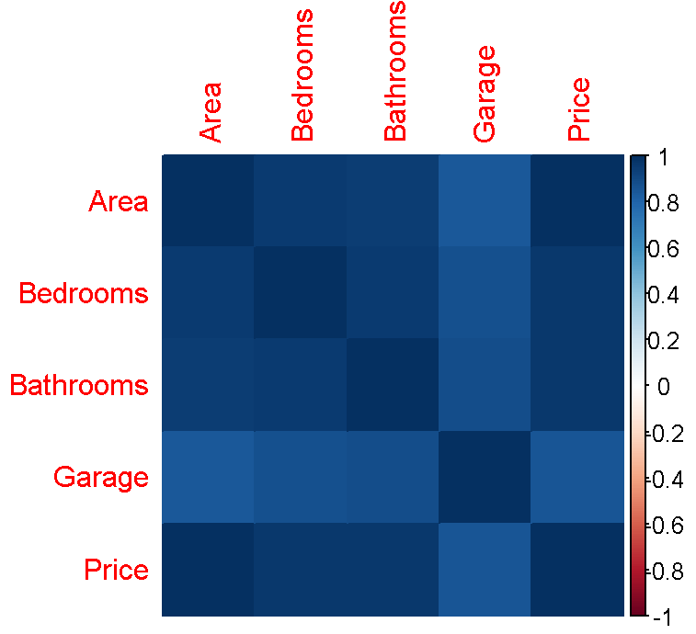
DESCRIPTIVE STATISTICS: Multivariate Exploration
Common Techniques with Examples
3. Colored Heatmaps of Correlation
Visualize correlation matrix for better interpretation.
Example: Housing Dataset
housing_data <- data.frame( Area = c(2100, 1600, 2400, 1410, 3000, 1900, 1100, 2750, 2200, 1350),
Bedrooms = c(3, 2, 4, 2, 4, 3, 1, 4, 3, 2),
Bathrooms = c(2, 1, 3, 1, 3, 2, 1, 3, 2, 1),
Garage = c(1, 0, 1, 0, 1, 1, 0, 1, 1, 0),
Price = c(460, 330, 590, 290, 690, 410, 210, 640, 500, 260))
Use: Use: Easily spot highly correlated variables that might affect model assumptions.

Slide 35
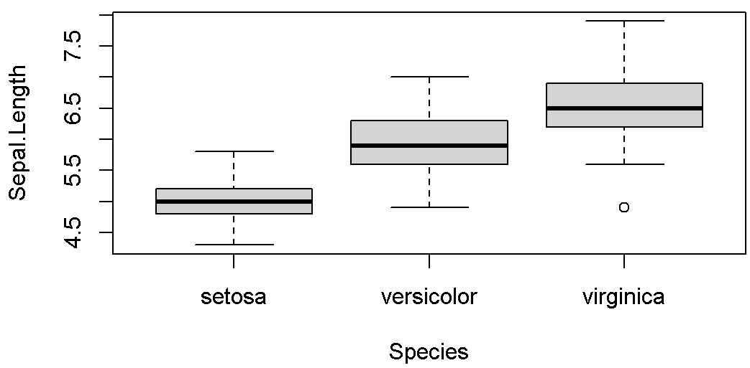
DESCRIPTIVE STATISTICS: Multivariate Exploration
Common Techniques with Examples
4. Boxplots Grouped by Categories
Compare numeric values across categorical variables.
boxplot(Sepal.Length ~ Species, data = iris)
Use: Explore how Sepal Length varies across different species.

Slide 36
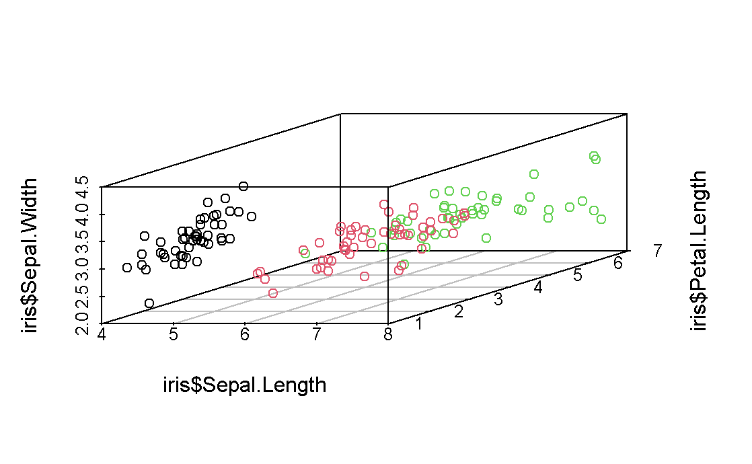
DESCRIPTIVE STATISTICS: Multivariate Exploration
Common Techniques with Examples
5. 3D Scatter Plot
For three variables at once (mostly numerical).
library(scatterplot3d)
scatterplot3d(iris$Sepal.Length, iris$Petal.Length, iris$Sepal.Width, color = as.numeric(iris$Species))
Use: Visualizes interactions between three variables simultaneously.

Slide 37
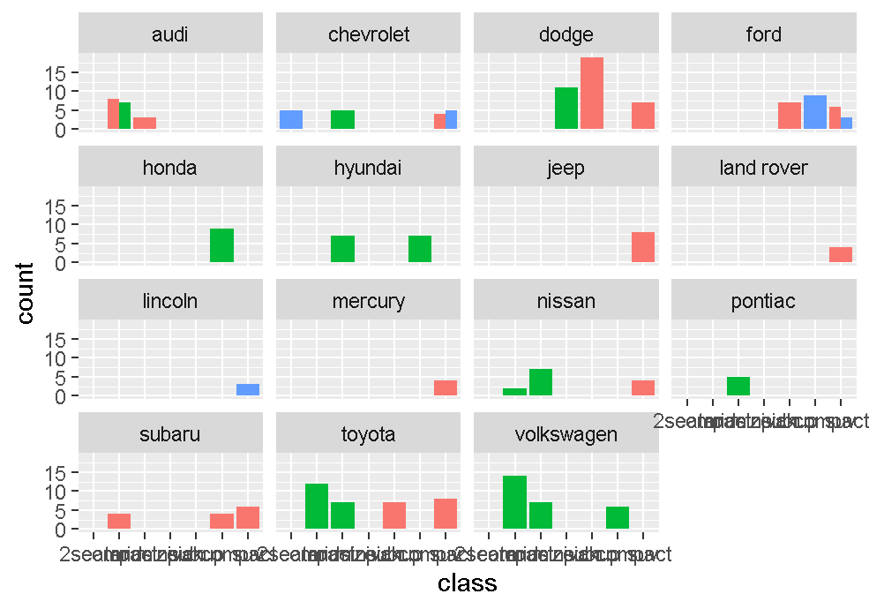
DESCRIPTIVE STATISTICS: Multivariate Exploration
Common Techniques with Examples
6. Grouped Bar Charts / Faceted Plots
Show the effect of one categorical and one numerical variable, often split by another category.
library(ggplot2)
ggplot(mpg, aes(x = class, fill = drv)) +
geom_bar(position = "dodge") +
facet_wrap(~ manufacturer)
Use: Understand relationships between multiple variables in a categorized manner..

Slide 38
DESCRIPTIVE STATISTICS: Multivariate Exploration

